Slide 1

Finding the most suitable location for a burger restaurant
May 2021

Slide 2
Market research is important for any new business venture
According to statistics, 40% of new business ventures fail within their first year
One of the reasons that have been linked to these failures is inadequate market research by the new venture
Understanding the market can help evaluate the decision of whether to go ahead with a business or not as well as the best way to take advantage of market gaps.
One important aspect of market research is identifying the right location for your business
In this project, we assisted a business to identify the best location for a burger restaurant in Johannesburg

Slide 3
Data Acquisition
The following data sets will therefore be required:
1) Neighborhoods in Johannesburg, South Africa
2) Economic data of the neighborhoods (and determination of most of the residence being above the median for low income -R12800 per month)
3) High schools, colleges and clubs in the area
4) Restaurants in a neighborhood, ranked from most to least common
The first dataset listed above was obtained from the city of Johannesburg website www.joburg.gov.za with particular interest in the suburbs of region A, which is the northern region. The demographic data (high schools, colleges and clubs.), and the restaurants can be obtained from Foursquare.
The economic data of the neighborhoods was obtained from www.statssa.gov, which is a government run national statistics website

Slide 4
Methodology
A clustering algorithm(k-means clustering) was chosen to be used to classify the suburbs/neighborhoods into the most ideal.
The reason a clustering algorithm was used was to have a quick way of grouping suburbs with the most common characteristics. Analysis of the labels would then indicate which group of suburbs were the most suitable.
The features for the model were chosen as the number of restaurants in the vicinity of the suburb/neighborhood, the number of schools in the neighborhood as well as the economic distribution of the suburb
The outcome of the algorithm was to produce a list of labels for the suburbs. The labels themselves did not make sense on their own until the suburbs were sorted according to the most common type of venues per suburb.

Slide 5
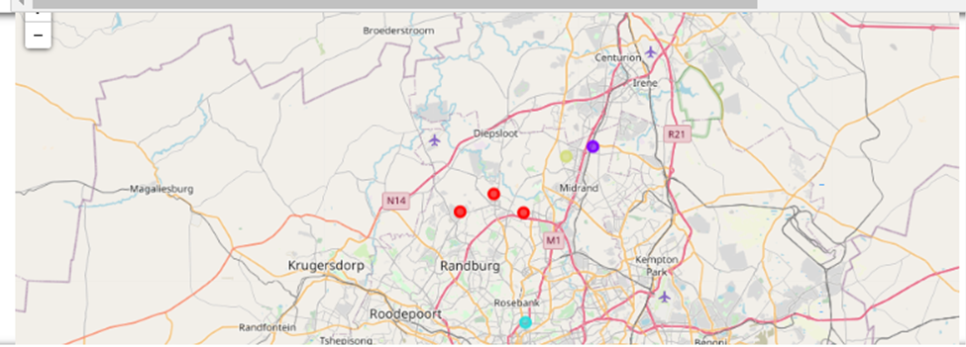
The most suitable suburbs where identified (Red in the map)

Slide 6
Conclusion
The purpose of the project was to identify the most suitable locations for a burger restaurant in the northern suburbs of Johannesburg
This was done using a clustering algorithm which identified the label which shows the most suitable suburbs for a burger restaurant
In the end, a number of suburbs were classified with this label of suitability, but only one was identified as the most suitable due to competition of other burger restaurants in the area.

